Slide 1
Gas Density
The density of gases is much less than that of liquids.
We can calculate the density of any gas at STP easily.
The formula for gas density at STP is:
molar mass in grams
= density, g/L
molar volume in liters

Slide 2
Calculating Gas Density
What is the density of ammonia gas, NH₃, at STP? N= 14.01 g; H = 1.01 g.
First we need the molar mass for ammonia;
14.01 + 3(1.01) = 17.04 g/mol
The molar volume NH₃ at STP is 22.4 L/mol.
Density is mass/volume:
17.04 g/mol
= 0.761 g/L
22.4 L/mol

Slide 3
Molar Mass of a Gas
We can also use molar volume to calculate the molar mass of an unknown gas.
1.96 g of an unknown gas occupies 1.00L at STP. What is the molar mass?
We want g/mol, we have g/L.
1.96 g
22.4 L
×
= 43.9 g/mol
1.00 L
1 mole

Slide 4
Mole Unit Factors
We now have three interpretations for the mole:
1 mol = 6.02 × 10²³ particles
1 mol = molar mass
1 mol = 22.4 L at STP for a gas
This gives us 3 unit factors to use to convert between moles, particles, mass, and volume.

Slide 5
Mole-Volume Calculation
A sample of methane, CH₄, occupies 4.50 L at STP. How many moles of methane are present?
We want moles, we have volume.
Use molar volume of a gas: 1 mol = 22.4 L
1 mol CH₄
4.50 L CH₄ ×
= 0.201 mol CH₄
22.4 L CH₄

Slide 6
Mass-Volume Calculation
What is the mass of 3.36 L of ozone gas, O₃, at STP?
We want mass O₃, we have 3.36 L O₃.
Convert volume to moles then moles to mass:
1 mol O₃
48.00 g O₃
3.36 L O₃ ×
×
22.4 L O₃
1 mol O₃
= 7.20 g O₃

Slide 7
Molecule-Volume Calculation
How many molecules of hydrogen gas, H₂, occupy 0.500 L at STP?
We want molecules H₂, we have 0.500 L H₂.
Convert volume to moles and then moles to molecules:
1 mol H₂
6.02×10²³ molecules H₂
0.500 L H₂ ×
×
22.4 L H₂
1 mole H₂
= 1.34 × 10²² molecules H₂

Slide 8
Law of Definite Composition
The law of definite composition states that “compounds always contain the same elements in a constant proportion by mass”.
Sodium chloride (NaCl) is always 39.3% sodium and 60.7% chlorine by mass, no matter what its source.
Water (H₂O) is always 11.2% hydrogen and 88.8% oxygen by mass.

Slide 9
Law of Definite Composition
A drop of water, a glass of water, and a lake of water all contain
hydrogen and oxygen in the same percent by mass.
Notes:
Figure: 04-08
Title:
Law of Definite Composition
Caption:
A drop of water, a glass of water, and a lake of water all contain hydrogen and oxygen in the same percent by mass, that is, 11.2% hydrogen and 88.8% oxygen.
Notes:
The Law of Definite Composition states that no matter its source, a compound contains the same elements in the same percents by mass.

Slide 10
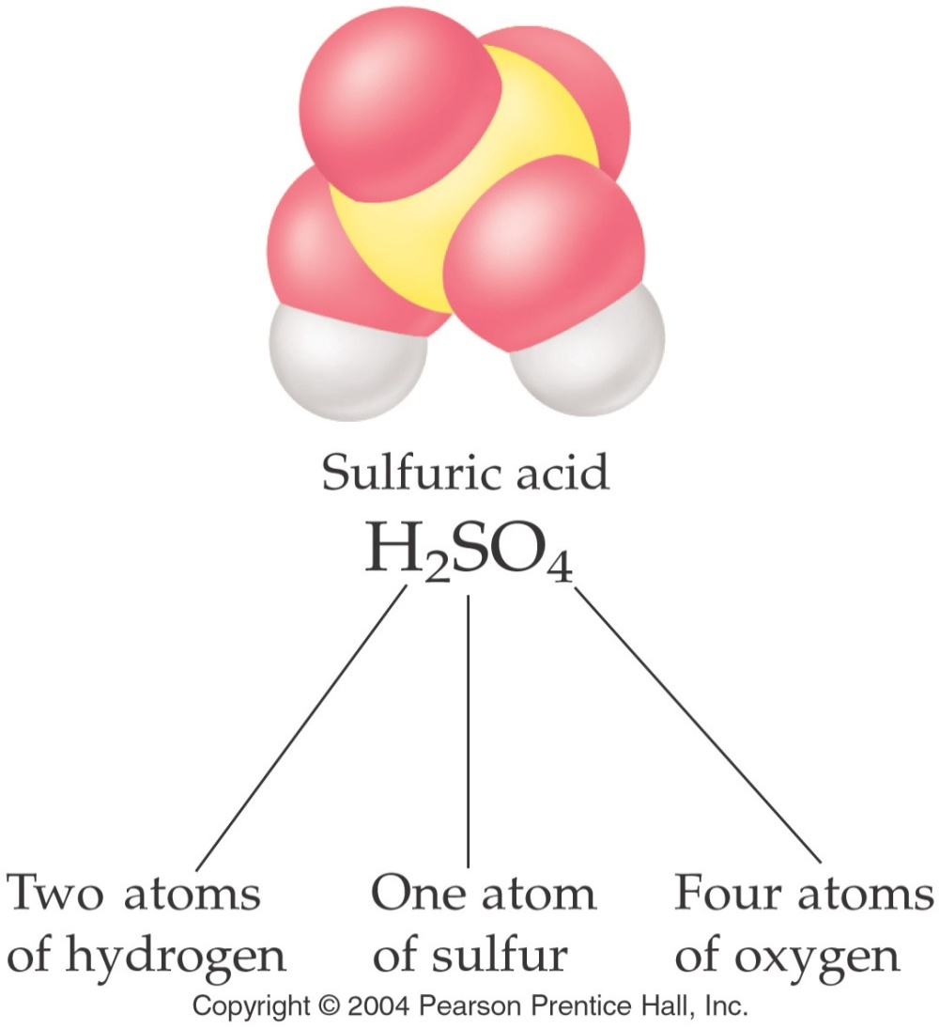
Chemical Formulas
A particle composed of two or more nonmetal atoms is a molecule.
A chemical formula expresses the number and types of atoms in a molecule.
The chemical formula of sulfuric acid is H₂SO₄.

Slide 11
Writing Chemical Formulas
The number of each type of atom in a molecule is indicated with a subscript in a chemical formula.
If there is only one atom of a certain type, no ‘1’ us used.
A molecule of the vitamin niacin has 6 carbon atoms, 6 hydrogen atoms, 2 nitrogen atoms, and 1 oxygen atom. What is the chemical formula? C₆H₆N₂O

Slide 12
Interpreting Chemical Formulas
Some chemical formulas use parenthesis to clarify atomic composition.
Antifreeze (ethylene glycol) has the chemical formula C₂H₄(OH)₂. There are 2 carbon atoms, 4 hydrogen atoms, and 2 OH units, giving a total of 6 hydrogen atoms and 2 oxygen atoms.
Total of 10 atoms.

Slide 13
Percent Composition
The percent composition of a compound lists the mass percent of each element.
For example, the percent composition of water, H₂O is:
11% hydrogen and 89% oxygen
All water contains 11% hydrogen and 89% oxygen by mass.

Slide 14
Calculating Percent Composition
There are a few steps to calculating the percent composition of a compound. Lets practice using H₂O.
Assume you have 1 mole of the compound.
One mole of H₂O contains 2 mol of hydrogen and 1 mol of oxygen.
2(1.01 g H) + 1(16.00 g O) = molar mass H₂O
2.02 g H + 16.00 g O = 18.02 g H₂O

Slide 15
Calculating Percent Composition
Next, find the percent composition of water by comparing the masses of hydrogen and oxygen in water to the molar mass of water:
2.02 g H
× 100% = 11.2% H
18.02 g H₂O
16.00 g O
× 100% = 88.79% O
18.02 g H₂O

Slide 16
Percent Composition Problem
TNT (trinitrotoluene) is a white crystalline substance that explodes at 240°C. Calculate the percent composition of TNT, C₇H₅(NO₂)₃.
7(12.01 g C) + 5(1.01 g H) + 3 (14.01 g N + 32.00 g O) = Total g C₇H₅(NO₂)₃
84.07 g C + 5.05 g H + 42.03 g N + 96.00 g O = 227.15 g C₇H₅(NO₂)₃.

Slide 17
Percent Composition of TNT
84.07 g C
× 100% = 37.01% C
227.15 g TNT
5.05 g H
× 100% = 2.22% H
227.15 g TNT
42.03 g N
× 100% = 18.50% N
227.15 g TNT
96.00 g O
× 100% = 42.26% O
227.15 g TNT

Slide 18
Empirical Formulas
The empirical formula of a compound is the simplest whole number ratio of ions in a formula unit or atoms of each element in a molecule.
The molecular formula of benzene is C₆H₆
The empirical formula of benzene is CH.
The molecular formula of octane is C₈H₁₈
The empirical formula of octane is C₄H₉.

